Slide 1


APPTAKE 1st Hackathon
2025, May 8th and 9th
Infinity
Luca Martini (luca.martini@edu.unige.it)
Subhransu Sourav Priyadarshan
(subhransu.priyadarshan@edu.unige.it)
The hackathon is organized as part of the activities of APPtake project. This project has received funding from the European Cybersecurity Competence Centre under grant agreement No 101128082.

Slide 2

Objectives
Potential Use Cases of the Dataset
02
02
The goal is to identify, examine, and categorize patterns in web activity to uncover suspicious or potentially harmful behavior. This involves tracking traffic patterns, spotting unusual activities, and identifying signs of cyber threats like unauthorized access, data leaks, or malicious actions. By using security analytics, the project seeks to strengthen threat detection and boost the overall security of web applications.
Anomaly Detection
Threat intelligence
Vulnerability reduction
Cybersecurity research
The hackathon is organized as part of the activities of APPtake project. This project has received funding from the European Cybersecurity Competence Centre under grant agreement No 101128082.
Notes:
By leveraging this dataset, security professionals and researchers can gain deeper insights into web-based threats, improve threat detection models, and enhance cybersecurity defenses against evolving attacks. By studying the patterns in the dataset, we aim to identify common attack patterns,assess their impact and explore advanced security mechanisms to counteract evolving cyber threats.

Slide 3
Anomalies
APPTAKE
Modelling Strategies
Model: Isolation Forest
Model: DBSCAN with PCA
Features:
Session duration
Data volume ratios
IP request patterns
What do we define as anomalies ?
Abnormal data flow (bytes ratio)
Bytes in and bytes out
Anomalies from different country, IP
The hackathon is organized as part of the activities of APPtake project. This project has received funding from the European Cybersecurity Competence Centre under grant agreement No 101128082.

Slide 4
Data Preprocessing
Handling Missing values
Handling outliers
Handling Data Inconsistencies

Slide 5
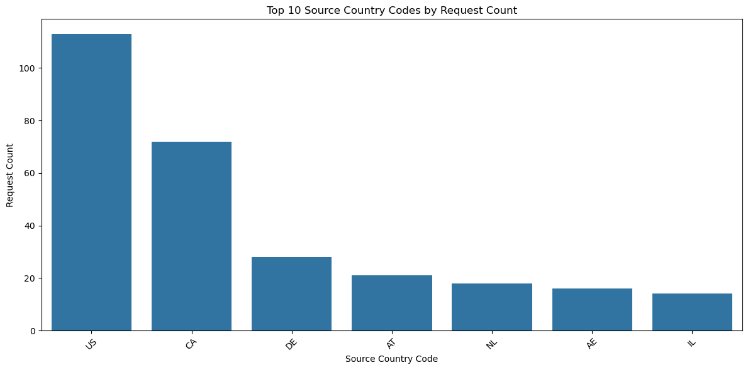
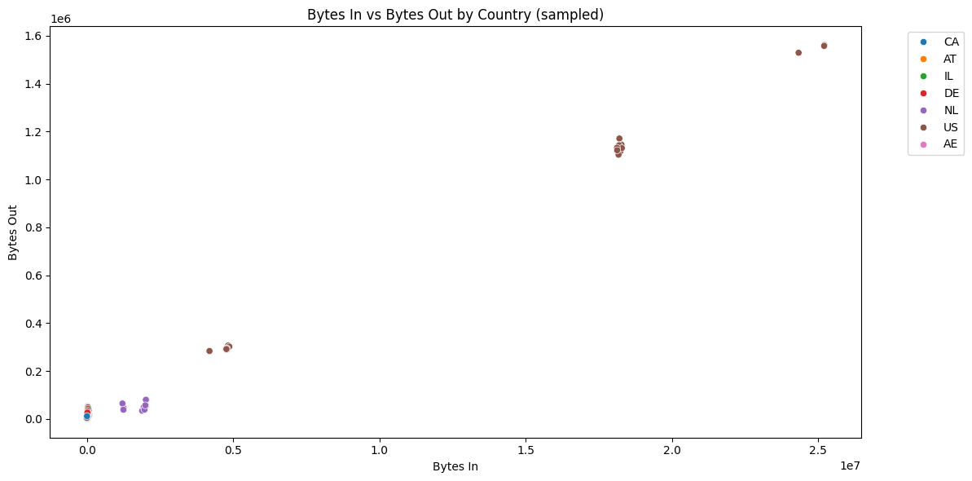
Exploratory Data Analysis (EDA)
Visualize IP distribution
Data Flow Patterns
Session Duration
Notes:
PCA is important to know which features in the dataset matter the most.

Slide 6
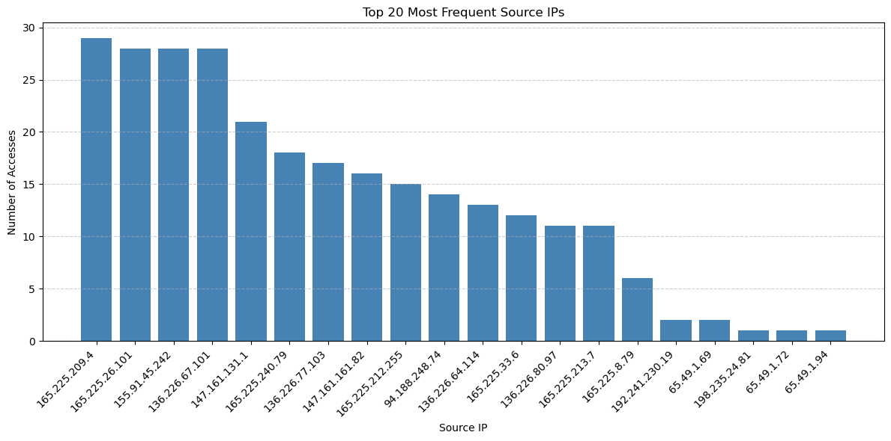
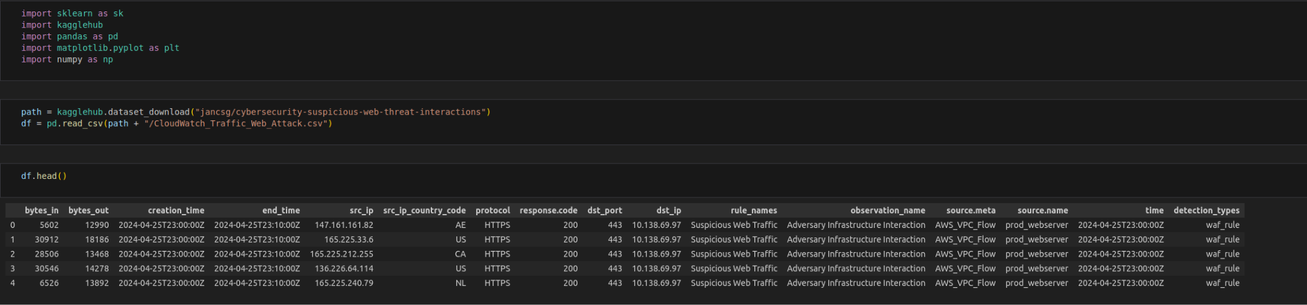
Feature Engineering
Duration
Bytes ratio Traffic rate (optional) (bytes/sec)
Time-based anomalies
Frequency of access by IP

Slide 7
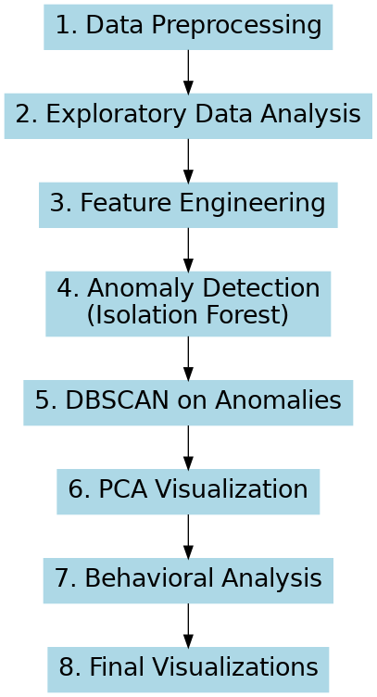
Workflow

Slide 8
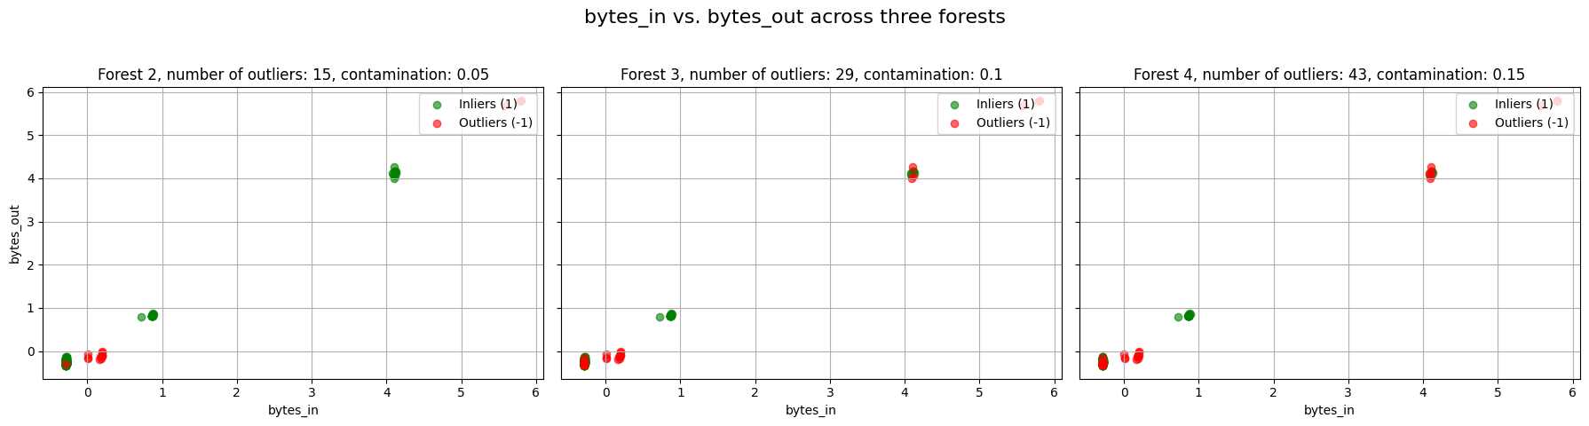
Modeling: Anomaly Detection
Isolation Forest Model
Parameter tuning with Grid Search
STEP 1: Try a range of values
contamination_values = [auto, 0.01, 0.05, 0.1, 0.15, 0.2, 0.3]
STEP 2: For each trial:
count how many anomalies were flagged to determine which value gives the best anomaly results
Plot score distribution
STEP 3: Choose the Best Fit Based on:
clear score separation
interpretability of visual anomalies
stability of outlier counts
Notes:
Since there is no labelled data, we are doing

Slide 9
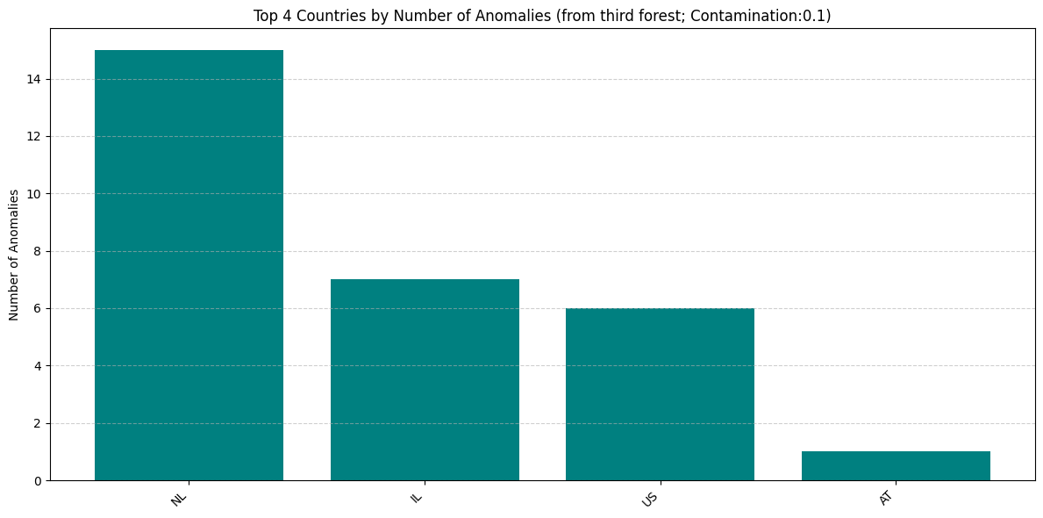
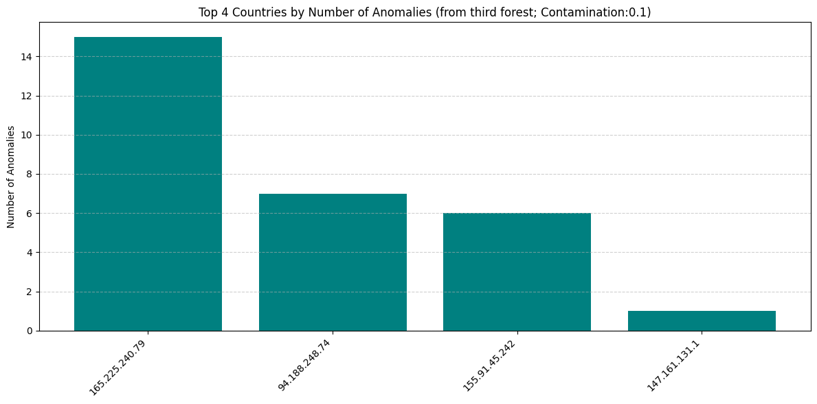
Focus on the behavior patterns
Notes:
In order to test performance, we carried out statistical testing on clustering algorithm.

Slide 10
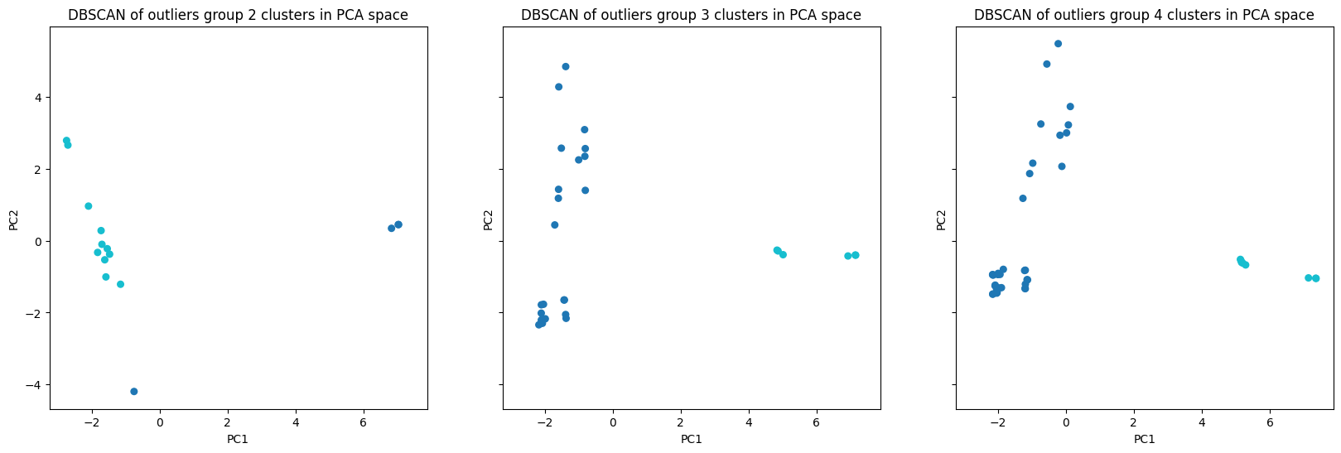
Focus on the behavior patterns
Notes:
In order to test performance, we carried out statistical testing on clustering algorithm.

Slide 11
Focus on the behavior patterns
► Top contributors in group_2
PC1:
bytes_out 0.6640
bytes_in 0.6312
bytes_ratio 0.2752
hour_cos 0.1491
src_ip_country_code_NL 0.1127
PC2:
bytes_ratio 0.8681
hour_sin 0.2723
hour_cos 0.2548
bytes_in 0.2478
bytes_out 0.2034
► Top contributors in group_3
PC1:
bytes_out 0.6728
bytes_in 0.6584
hour_cos 0.1918
hour_sin 0.1680
src_ip_155.91.45.242 0.1269
PC2:
bytes_ratio 0.9598
src_ip_165.225.240.79 0.1489
src_ip_country_code_NL 0.1489
src_ip_94.188.248.74 0.1173
src_ip_country_code_IL 0.1173
► Top contributors in group_4
PC1:
bytes_out 0.6478
bytes_in 0.6417
hour_cos 0.2185
hour_sin 0.2065
bytes_ratio 0.1916
PC2:
bytes_ratio 0.9375
src_ip_165.225.240.79 0.1727
src_ip_country_code_NL 0.1727
bytes_out 0.1676
bytes_in 0.1060
Notes:
In order to test performance, we carried out statistical testing on clustering algorithm.

Slide 12
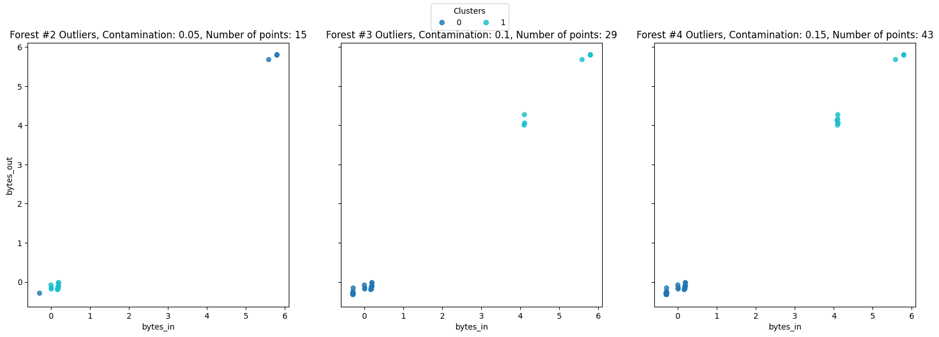
Focus on the behavior patterns
Notes:
In order to test performance, we carried out statistical testing on clustering algorithm.

Slide 13
THANKS

